Slide 1

AI Abuse in The Entertainment Industry
Ryan Yauch – ITAI 2372

Slide 2
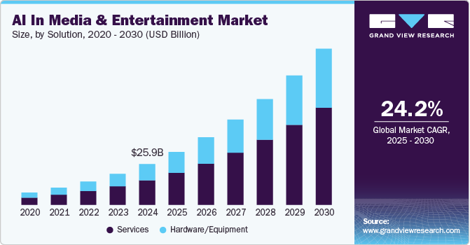
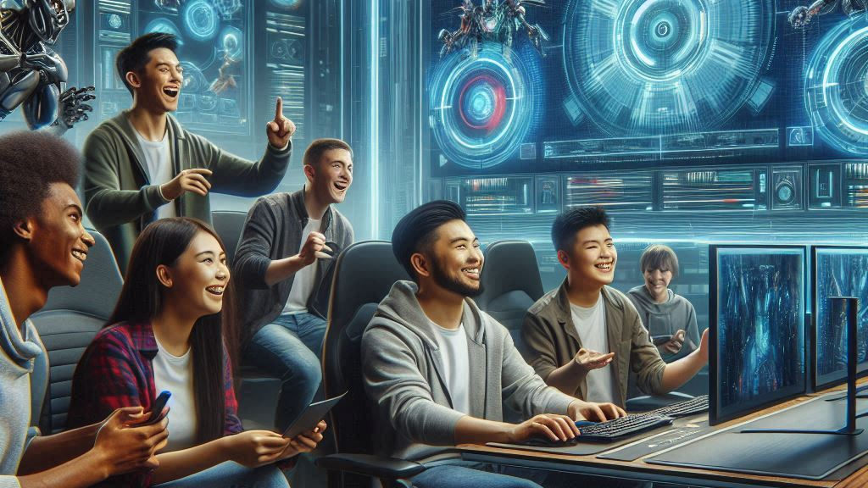
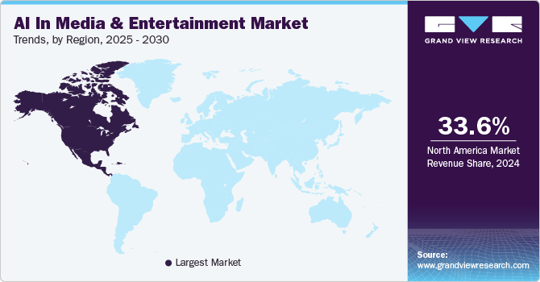
AI Technology/Implementation
AI in the Entertainment Industry is used to increase accessibility to creators and simplify creation, editing, and production of media.
Generative AI is trained off existing media, whether it be art, music, video, or games to learn and produce an output similar to what it was trained on.
Machine Learning models can learn off user trends, like how Spotify uses AI to based on listening trends to give users personalized playlist and song recommendations.
Performance for games can be enhanced through systems like Nvidia’s DLSS, which both upscales lower resolutions, and generates frames for smoother gameplay without the heavy performance.

Slide 3
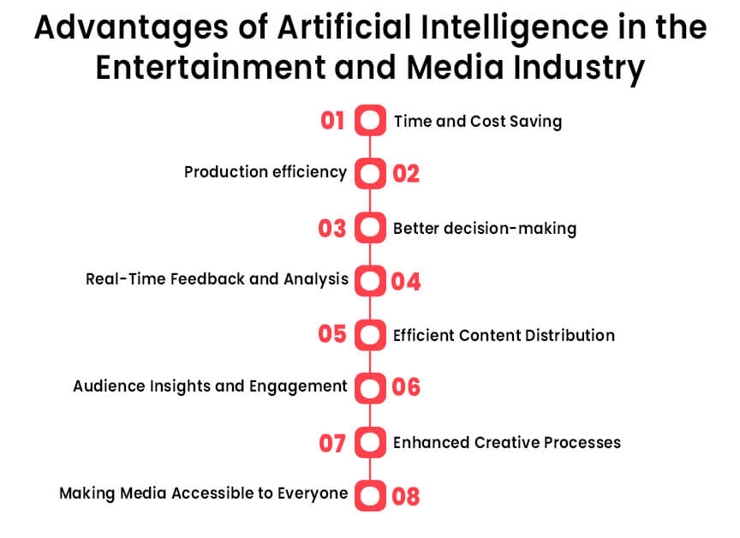
Benefits
Media creation is more accessible, without the need of band members or instruments, composers can create tracks by using online resources and AI tools.
Game performance for lower end systems is improved through frame generation and upscaling, providing accessibility to games on lower-end systems.
Art or Assets can be generated making it easier and cheaper for indie devs to create assets they may need for game creation.
Creative Blocks can be overcome with story or theme recommendations to help artists create new tracks.

Slide 4
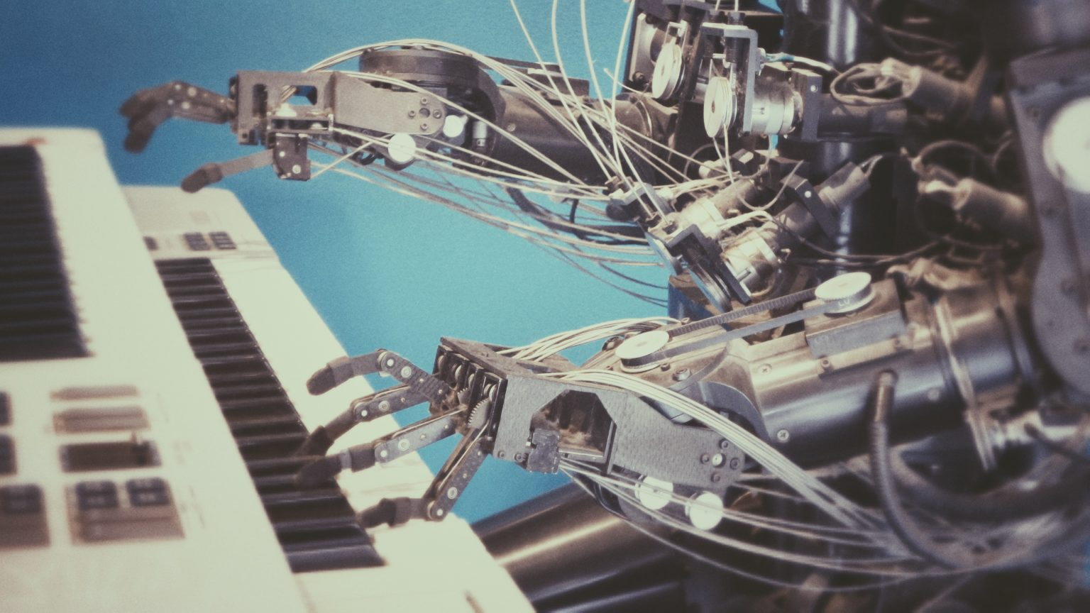
Challenges
Since AI is more efficient and cheaper, it threatens creative jobs in the entertainment industry, this includes writers, concept artists, animators, and more.
AI can violate copyright, using the data to create new media without the consent of the right holders, abusing their work for gain.
AI creates a disconnect from human creativity and passion, and for media like music people lose connections to what they’re listening to.

Slide 5

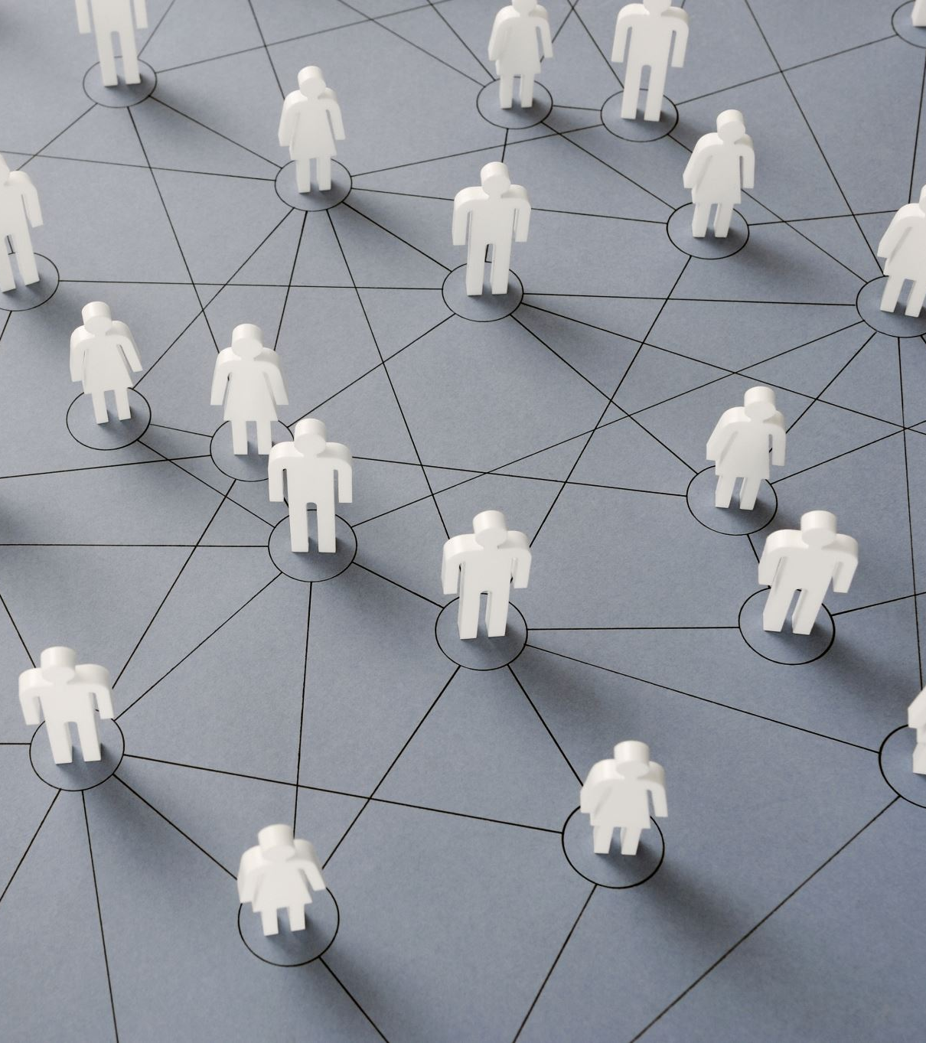
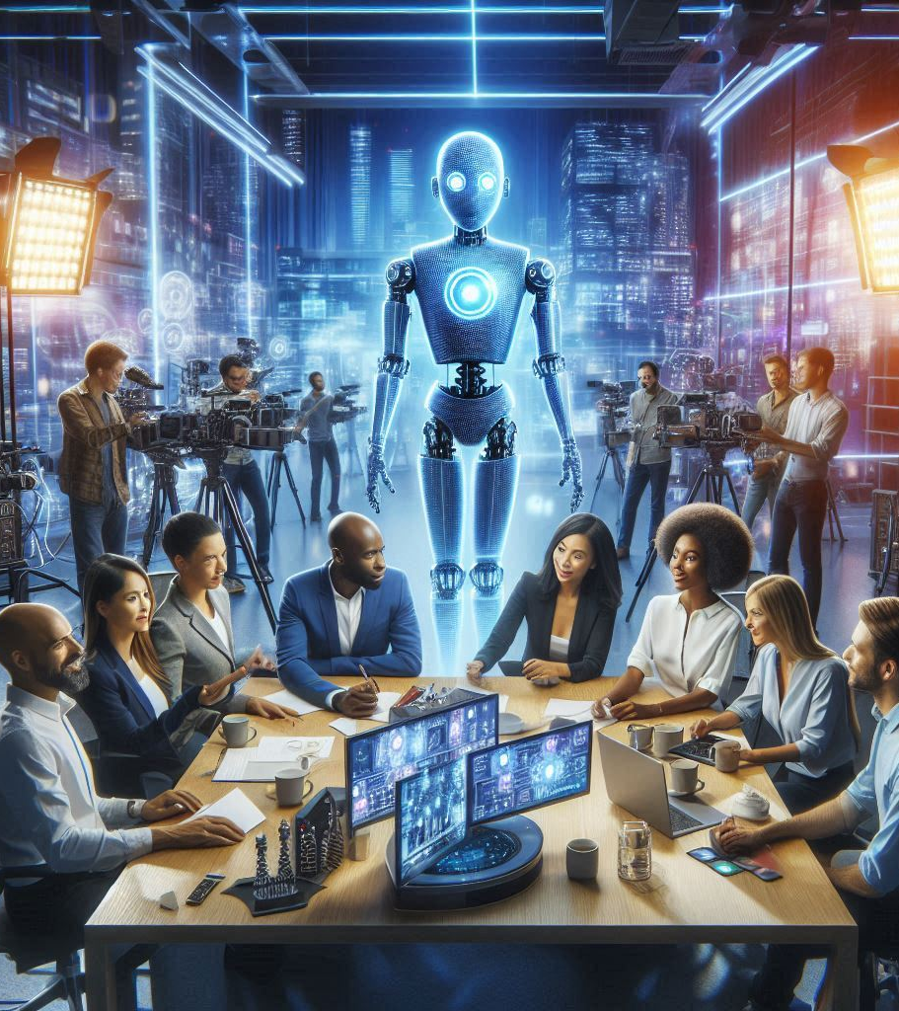
Ethical Concerns
Ethical concerns relate around the loss of human creativity, lack of transparency, stolen work, and overuse of AI.
Without human creativity being used to create entertainment, AI generated content loses its “humanity” and appeal to many people seeking a deeper connection.
The lack of transparency brings up concerns with stolen work and copyright violation, since it may not be clear what models are trained on.
The overuse of AI can flood platforms with content, where it becomes hard to tell what is real and what’s AI, leading to bias on legitimate artists and repetitive content on all entertainment platforms.

Slide 6

Societal Impact
With AI, smaller creators are able to make and experiment with different entertainment media with cheaper tools and great resources.
Entertainment will be personally tailored to each user individually, able to interact with AI to create stories, music, or games that they want.
More individuals can experiment and make projects with the help of AI, leading either to laziness and reliance on AI, or gaining interest and inspiration for work.
With the overuse of AI, models will begin training off other AI work, leading to repetitive, unoriginal, and lack of creativity in the industry.
Jobs become less available as AI gets better, since it becomes cheaper and faster to maintain AI rather than human workers.
AI bias will be put on real or original pieces of work, artists and creators needing to provide proof of creation to validate their work.

Slide 7

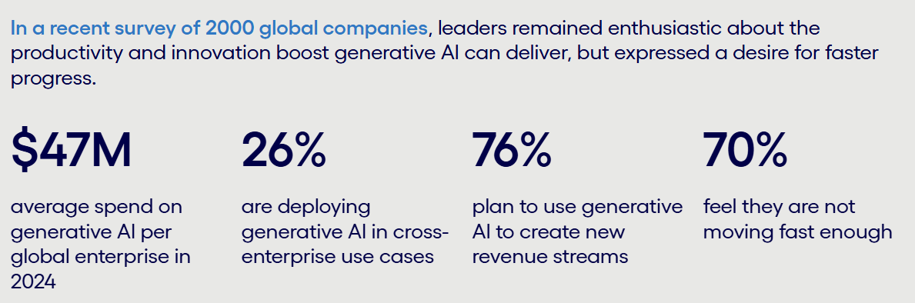
Future of AI
Future AI advancements will make production cheaper, and easier than ever, able to generate ideas, assets, and publish media all on its own.
Development will be more accessible to everyone, with tools and resources able to be gathered or created by AI with a simple prompt.
Accessibility to higher-end media, like intensive games will be possible on lower-end systems with AI GPU tools becoming more powerful, running them at a fraction of the cost.
Suspicion of AI will grow, as it gets better and harder to tell what’s AI, creators work will begin to get invalidated, used for training, or lose it’s impact.

Slide 8
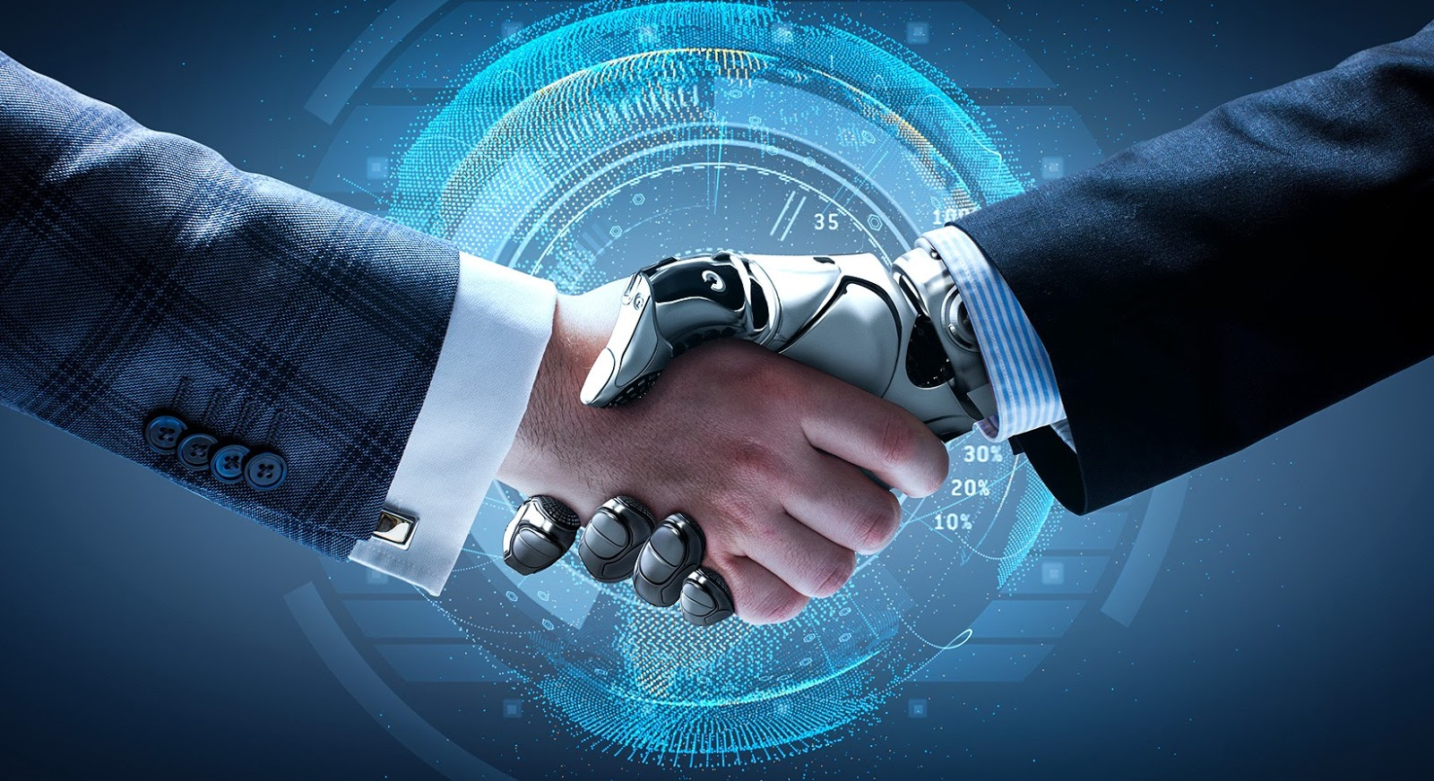
Recommendations
Making AI more transparent will build trust, knowing exactly what it’s trained on can remove fear of copyright violations, or stolen work.
Transparency also helps creators accept AI, as it’ll be more obvious if data is trained on copyrighted or stolen material, increasing the amount of consent needed for data training.
Identifying what is AI and what is real will reduce people mistaking AI for original content, and original content for AI generated content.
This Photo by Unknown Author is licensed under CC BY-SA

Slide 9

References
AI In Media & Entertainment Market Size, Share Report, 2030 (Slide 2 Chart)
The Impact of AI in Entertainment and Media Industry (Slide 3 Graphic)
Accelerate AI at Scale | Cognizant (Slide 7 Graphic)

